Slide 1
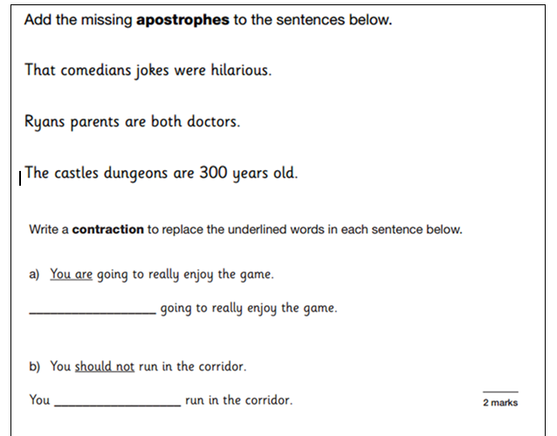
LO: Plan Narrative Writing

Slide 2
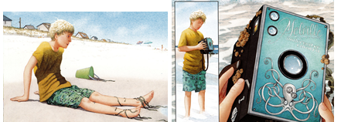
Feelings and action

Slide 3
Success criteria
-ed / -ing sentence start
Semicolon / colon to link sentence
Speech punctuation
Fronted adverbial (with comma)
Prepositional phrases
Noun phrases (adjective noun)
Paragraphs

Slide 4
Opening paragraph
Discombobulated and bedraggled after the wave had tossed him onto the shore, Ben sat for a moment to catch his breath. As he looked around he was surprised to see in front of him a strange box that had also been washed onto the beach. 'what is it'? ' he thought to himself as he staggered over to it.
Curious, he picked it up. Peering closely, he could see..

