Slide 1
Contents
The links below take you to the starting slide of each learning outcome.
1 | Pupils explain what area is and can measure using counting as a strategy (I)
2 | Pupils explain what area is and can measure using counting as a strategy (II)
3 | Pupils explain how to make different shapes with the same area
4 | Pupils explain how to compare the area of different shapes
5 | Pupils measure the area of flat shapes area using square centimetres
6 | Pupils measure the area of flat shapes area using square metres
Click the arrow button to return to this Contents slide.

Slide 2
Contents
The links below take you to the starting slide of each learning outcome.
7 | Pupils calculate the area of a rectangle using multiplication
8 | Pupils calculate the area of rectilinear shapes
9 | Pupils use their knowledge of area to solve problems
10 | Pupils compare and describe lengths by using their knowledge of multiplication
11 | Pupils use their knowledge of multiplication to solve comparison and change problems
12 | Pupils compare and describe lengths by using their knowledge of division
Click the arrow button to return to this Contents slide.

Slide 3
Contents
The links below take you to the starting slide of each learning outcome.
13 | Pupils use their knowledge of division to solve comparison and change problems
14 | Pupils compare and describe measurements by using their knowledge of multiplication and division (mass/capacity/time) (I)
15 | Pupils compare and describe measurements by using their knowledge of multiplication and division (mass/capacity/time) (II)
16 | Pupils describe the changes in measurements using their knowledge of multiplication and division
17 | Pupils use their knowledge of multiplication and division to solve comparison and change problems
Click the arrow button to return to this Contents slide.

Slide 4
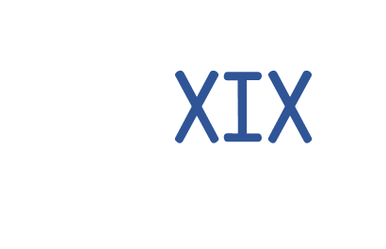
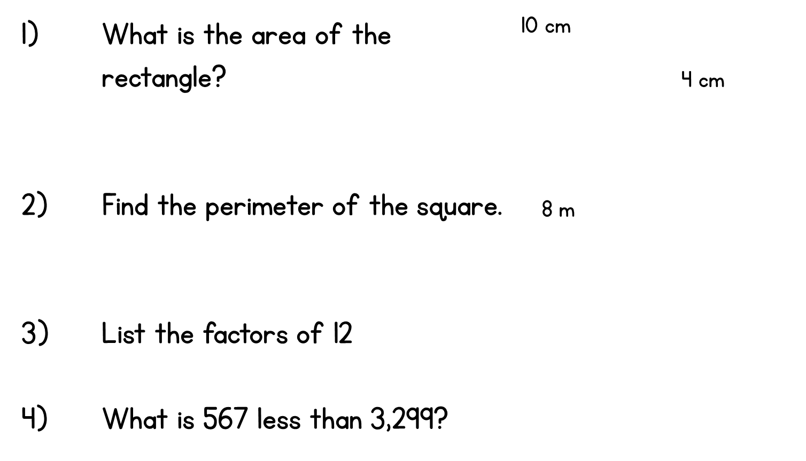
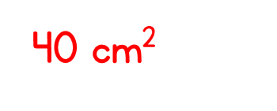
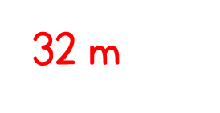
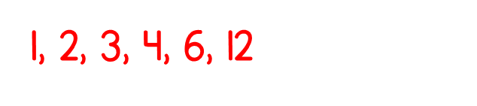
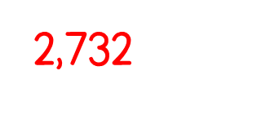
LO: Measures and Scaling
Year 5 | Week 12 | Day 2

Slide 5
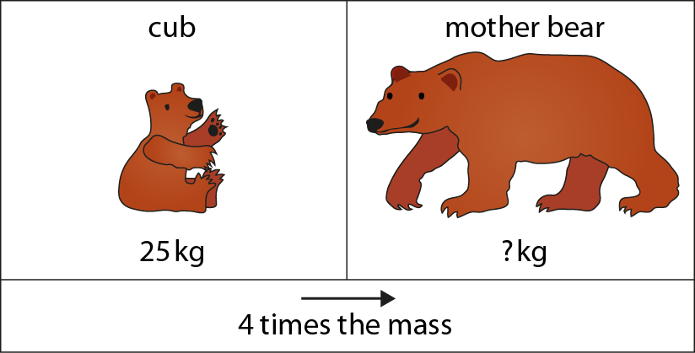

2.17 Scaling: measures and comparison Step 3:1
25 kg × 4 = kg
100
Notes:
The mass of a mother bear is four times the mass of her cub.

Slide 6
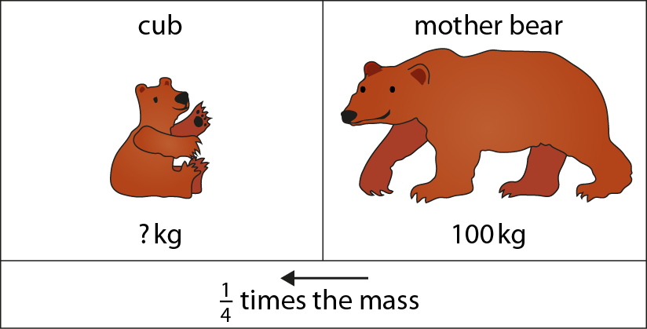

2.17 Scaling: measures and comparison Step 3:1
25
kg
100 kg ÷ 4 = kg
25
Notes:
The mass of a bear cub is one quarter the mass of his mother.

Slide 7
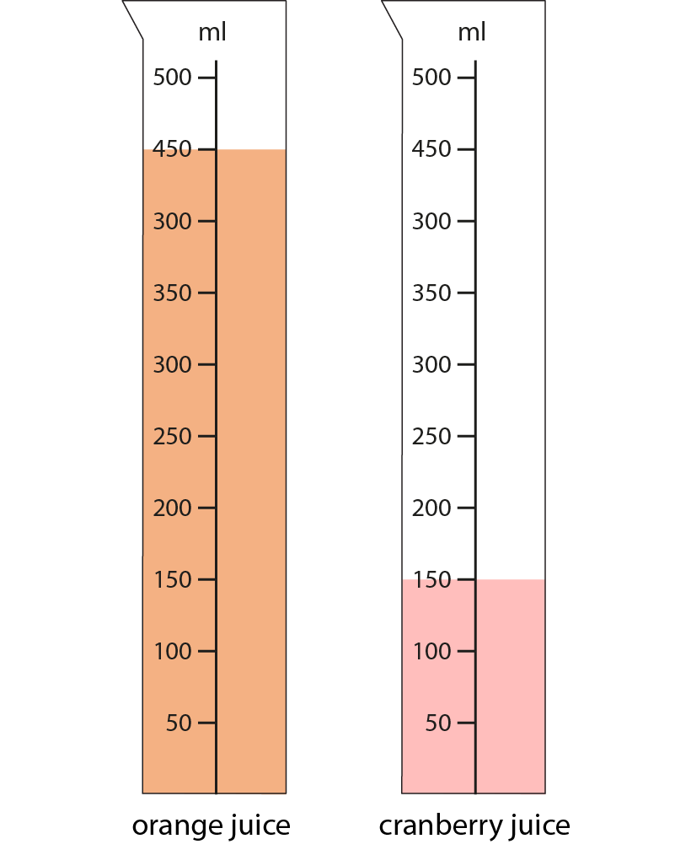
2.17 Scaling: measures and comparison Step 3:2
150 ml × 3 = 450 ml
450 ml ÷ 3 = 150 ml
Notes:
The volume of orange juice is three times the volume of cranberry juice.
The volume of cranberry juice is one third the volume of orange juice.

Slide 8
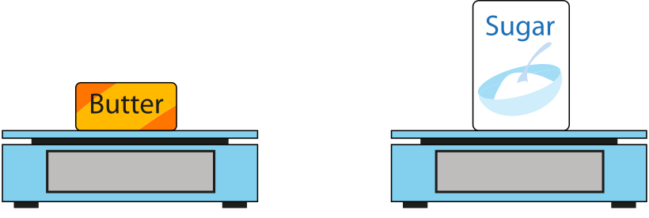
2.17 Scaling: measures and comparison Step 3:2
How much does the sugar weigh?
500 g
1000 g
× 2 =
? g
Notes:
The weight of the sugar is two times/twice/double the weight of the butter.
How much does the sugar weigh?

Slide 9
2.17 Scaling: measures and comparison Step 3:2
150 ml × 3 = 450 ml
450 ml ÷ 3 = 150 ml
Notes:
The volume of orange juice is three times the volume of cranberry juice.
The volume of cranberry juice is one third the volume of orange juice.

Slide 10
2.17 Scaling: measures and comparison Step 3:2
How much does the sugar weigh?
500 g
1000 g
× 2 =
? g
Notes:
The weight of the sugar is two times/twice/double the weight of the butter.
How much does the sugar weigh?

Slide 11
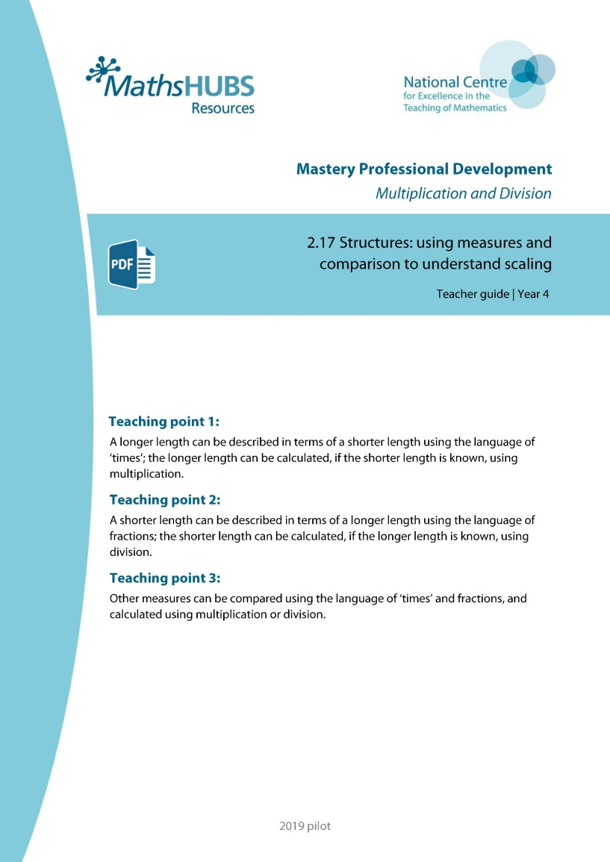
Year 5, Unit 5, Learning Outcome 17
Additional teacher guidance for this outcome should be read first and can be found in this segment of the NCETM Primary Mastery Professional Development Materials:
2.17 Structures: using measures and comparison to understand scaling
The spine materials are divided into ‘teaching points’ and ‘steps in learning’.
Teaching point | Steps in learning | Pages
3 | 3:3 (1:7 and 2:6) | 16

Slide 12
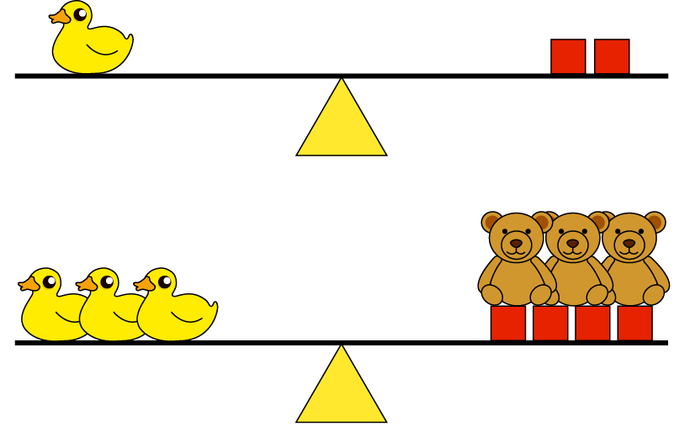
2.17 Scaling: measures and comparison Step 3:3
A duck is times as heavy as a brick
2
3
A duck is times as heavy as a bear
3
bears weigh the same as 2 bricks.

