Slide 1
21.03.22 Fluency
Fact of the day: 4 x 9=
Everyone | Extension
234 + 25 b. 456 + 37 c. 237 + 174 Difference between: 16 and 22 (do in your head) d. 24 + 24= Missing numbers? 3, 7, 11, ___, 19, __ | f. Write in figures eight thousand eight hundred and eighty g. How many minutes break do you get per school day? h. What is the difference between six hundred and 571? 1783 + 235 j. 9 squared subtract 3 squared.

Slide 2
22.03.22 Fluency
Fact of the day: 4 x 12=
Everyone | Extension
What is the sum of 176 and 65 (column) b. How many 10p in £1.30? c. 2m 6cm = ______cm d. Find the difference between 98 cm and 103cm e. Add half of 10, to 26. | f. Half of 2 l (litre) 500ml ? g. What is 15 out of 100 as a percentage? h. I need 530cm of rope. I have 1m 20cm. How much more do I need? 30 minutes more than 10.40am j. ____= 33 x 4 (you could x2 then x2 again) Show jottings

Slide 3
23.03.22 Fluency
Fact of the day: 4 x 6=
Everyone | Extension
26 + 19 Round and adjust b. 24 + 9 Redistribute c. Write 443 in words d. 89cm + ___cm= 100cm ___ cm + 25cm= 1m e. One quarter of 100= f. 2m and 7cm = _____cm g. 876cm = _____m ___cm | h. 8129 expanded: _____+ ___ + __+_ Add together eight and twelve, then multiply the result by fifty. j. How could you pay? Draw two ways with coins: £2.48 k. Write the multiple of 7 nearest 40. l. When n has the value 15, calculate 2n plus 2n.

Slide 4
24.03.22 Fluency
Fact of the day: 4 x 8=
Everyone | Extension
Difference between 37 and 41 48 and 55 b. 100 minus 25 c. £1.25 + ___= £2.00 d. Double 15, then add 20. e. Half of £2.30 f. 360p= £___.____ | g. What number is forty two more than one hundred and fifty-eight? h. 5 squared +___=100 A banana costs 25p. How much would 4 bunches of eight bananas cost? j. 50% sale. How much is an Easter egg priced £5.30?

Slide 5
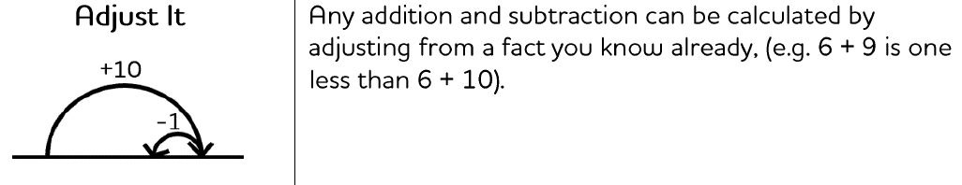
Monday afternoon fluency

Slide 6
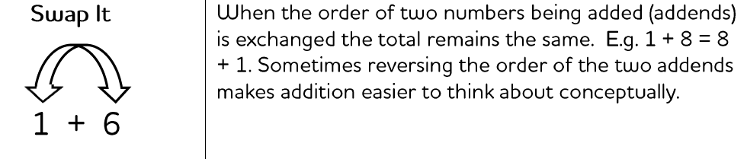
Tuesday afternoon fluency

Slide 7
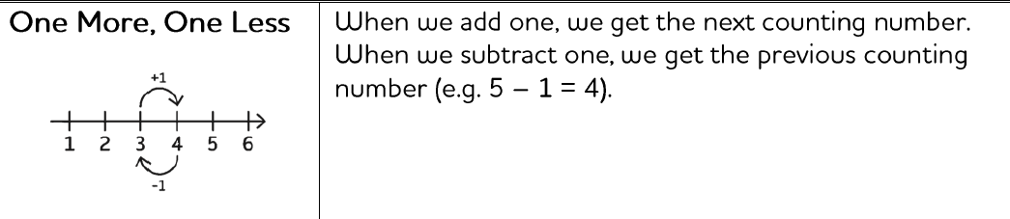
Wednesday afternoon fluency

Slide 8
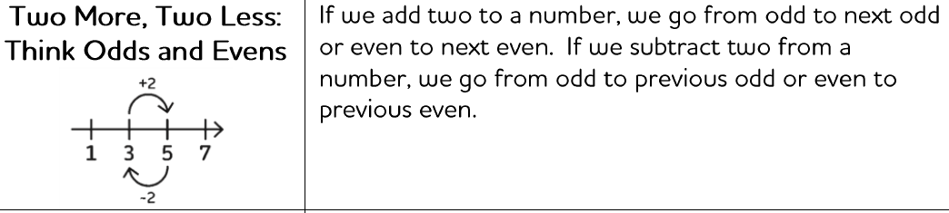
Thursday afternoon fluency

Slide 9
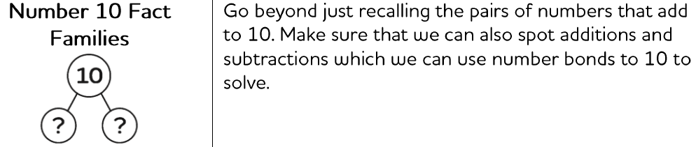
Friday afternoon Fluency

