Slide 1

07.02.22 Fluency
Fact of the day: 12 x 2=
Everyone | Extension
a. How many groups of 4 make 20? b. 16 children in groups of 4. How many groups? c. Difference between: 46 and 57 d. Value of digit 6? 683 Missing numbers? 3, __, 7, 9, __, 13, 15 | f. My number is greater than 26, less than 34 and a multiple of 5. What is it? g. 1000 ÷ 25= h. Name 2 numbers with a sum of 16 and a difference of 2 1/5 of 150= 2/5 of 150= 3/5 of 150=

Slide 2
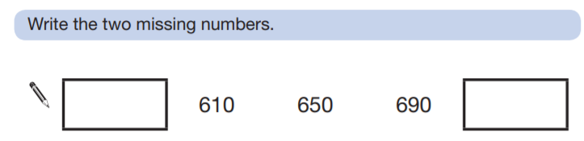
08.02.22 Fluency
Fact of the day: 11 x 5=
Everyone | Extension
What is the sum of seven and seventy-seven? b. How many tens in one hundred and twenty? c. 75g= ___g + 5g 75g= ___g + 25g d. Find the difference between 135 and 172 e. Add half of 4, to 8. | f. g. What is ¼ of 200? ¾ of 200? h. V + V= IV x II= X divided by v= M halved= L doubled=

Slide 3
09.02.22 Fluency
Fact of the day: 4 x 6=
Everyone | Extension
45 + 11 Round and adjust b. 16 + 19 Redistribute c. Write 407 in words d. 30cm + ___cm= 100cm ___ + 75cm = 100cm e. One quarter of 12= f. 1m and 35cm = _____cm g. 200cm = _____m | h. 3333 expanded: _____+ ___ + __+_ i. Which is bigger? 1/2 of 120 or 1/3 of 150 j. How many quarters in 2 and a half? k. Write the multiple of 6 nearest 40. l. 1, 4, 9, ___, 25, 36, 49

Slide 4
10.02.22 Fluency
Fact of the day: 4 x 7=
Everyone | Extension
Difference between 27 and 32 36 and 47 b. 100 minus 75 c. Write 10 in Roman numerals. d. Double 15, then add 20. e. Half of £2.60 f. 350p= £___.____ | g. Round to nearest 10p £2.67 £10.45 £6.21 h. 12 squared +___=150 i. Andrew had £44. He spent ¼ of his money on science books. How much has he LEFT? j. 50% sale. How much is an Easter egg priced £5?

Slide 5
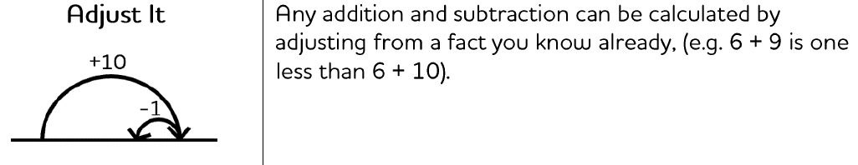
Monday afternoon fluency

Slide 6
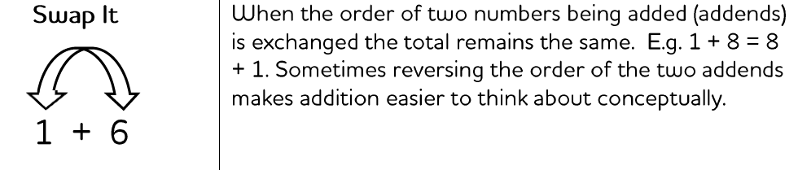
Tuesday afternoon fluency

Slide 7
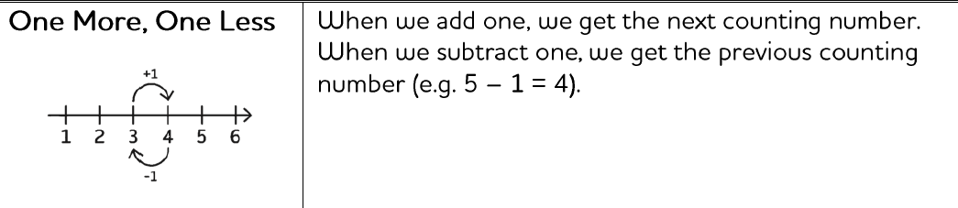
Wednesday afternoon fluency

Slide 8
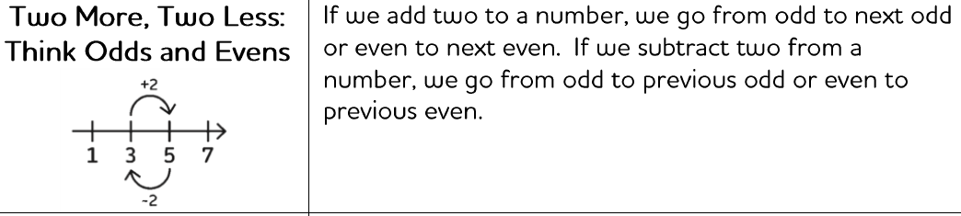
Thursday afternoon fluency

Slide 9
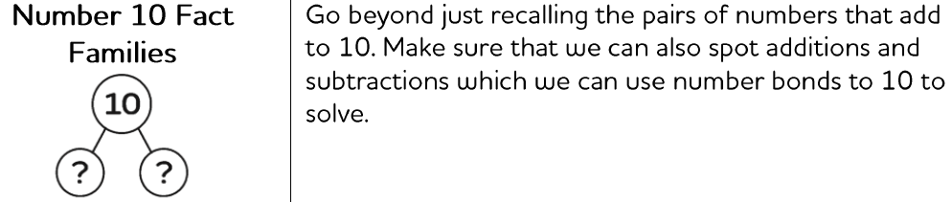
Friday afternoon Fluency

