Slide 1
08.03.22 Fluency
Fact of the day: 4 x 6=
Everyone | Extension
How many groups of 4 are there in 16? b. 100 ÷ ___= 50 c. Difference between: 36 and 42 (do in your head) d. 18 + 18= Missing numbers? 22 ___ 18 ___ 14 12 | f. Write in figures three thousand, three hundred and three g. How many minutes are there in 2 and a half hours? h. What is the difference between seven hundred and 489? Write the number between one hundred and twenty and one hundred and thirty whose digits add up to ELEVEN. j. 6 squared subtract 4 squared.

Slide 2
09.03.22 Fluency
Fact of the day: 2 x 11=
Everyone | Extension
What is the sum of 76 and 62 (column?) b. How many 10p in £1.20? c. 1m 56cm = ______cm d. Find the difference between 48 cm and 53cm e. Add half of 10, to 16. | f. Half of 1 l (litre) 500ml ? g. What is 15 out of 100 as a percentage? h. I need 530cm of rope. I have 2m 30cm. How much more do I need? 20 minutes more than 10.40am j. ____= 86 x 4 (you could x2 then x2 again) Show jottings

Slide 3
10.03.22 Fluency
Fact of the day: 4 x 6=
Everyone | Extension
57 + 19 Round and adjust b. 106 + 9 Redistribute c. Write 808 in words d. 75cm + ___cm= 100cm ___ cm + ½ m = 100cm e. One quarter of 100= f. 2m and 9cm = _____cm g. 900cm = _____m | h. 8520 expanded: _____+ ___ + __+_ Add together eight and seven, then multiply the result by four. j. How could you pay? Draw two ways with coins: £3.25 k. Write the multiple of 7 nearest 30. l. When n has the value 15, calculate 2n minus 5.

Slide 4
03.03.22 Fluency
Fact of the day: 4 x 12=
Everyone | Extension
Difference between 67 and 71 38 and 45 b. 100 minus 20 c. £1.75 + ___= £2.00 d. Double 15, then add 70. e. Half of £1.60 f. 650p= £___.____ | g. What number is thirty-four more than fifty-eight? h. 5 squared +___=200 i. A yogurt costs forty-five pence. How many yogurts can be bought for five pounds? Would there be any change? j. 50% sale. How much is an Easter egg priced £4.30?

Slide 5
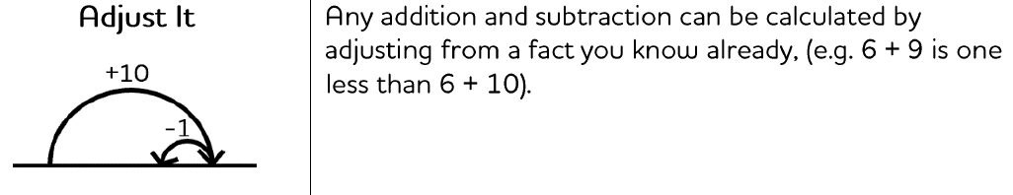
Monday afternoon fluency

Slide 6
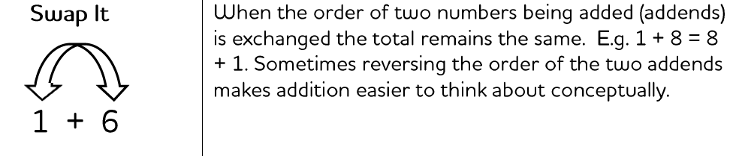
Tuesday afternoon fluency

Slide 7
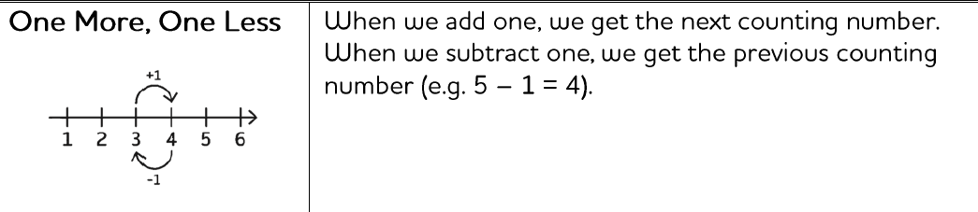
Wednesday afternoon fluency

Slide 8
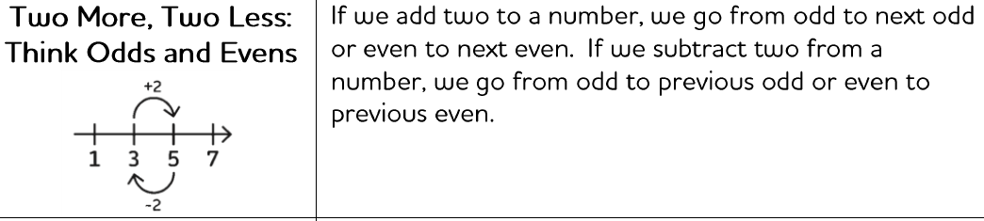
Thursday afternoon fluency

Slide 9
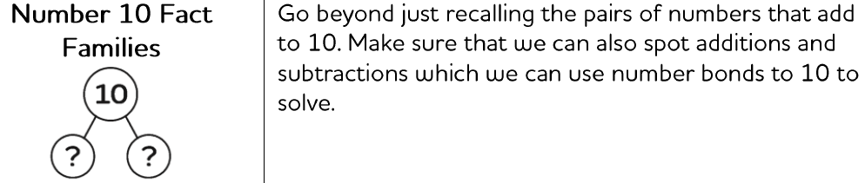
Friday afternoon Fluency

