Slide 1
09.05.22 Fluency
Fact of the day: 4 x 4=
Everyone | Extension
Use column method out work out: 234 + 125 374 + 217 381 – 163 584 - 326 | Find the difference between 317 and 246 418 and 219 78 and 694

Slide 2
10.05.22 Fluency
Fact of the day: 3 x 8=
Everyone | Extension
Column methods: 167cm + 46cm 762g + 241g £786 minus £77 59p less than 378p | e. 676cm + 538cm f. 462ml + 228ml g. 376g - 139g h. 408km – 136km

Slide 3
11.05.22 Fluency
Fact of the day: 6 x 4=
Everyone | Extension
Which are the odd numbers? 27 31 28 31 55 b. 60 + __= 100 79 + __=100 c. 20 divided by 4=_____ 43, 53, 63, 73, ___, 93,__ e. 645, 545, ___, 345, ___, _ | Order smallest first 8.9 8.7 9.8 7.8 g. Add together 765 and 908 using column. Write the answer in words. h. In which numbers does the 4 represent 4 tens: 740 42.4 104 146 14 j. When n has the value 35, calculate 2n plus n-5.

Slide 4
12.05.22 Fluency
Fact of the day: 4 x 7=
Everyone | Extension
Difference between 38 and 44 99 and 107 b. 100 minus 75 c. £1.50 + ___= £2.00 d. Double 15 add double 8 e. Half of £4.66 f. 567p= £___.____ | g. What number is eighty eight more than four hundred and fifty-eight? h. 6 squared +___=100 An apple costs 8p. How much would 2 bags of 6 apples cost?? j. 50% sale. How much is a water pistol which cost £6.38 pre-sale?

Slide 5
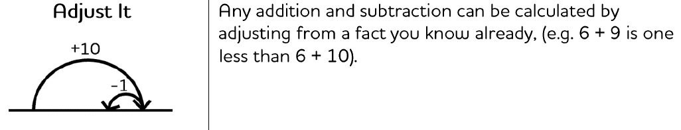
Monday afternoon fluency

Slide 6
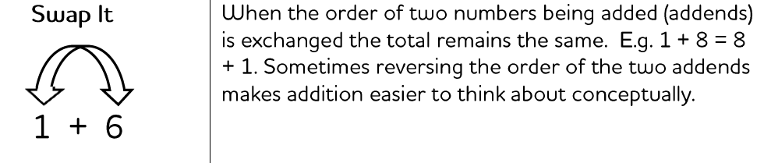
Tuesday afternoon fluency

Slide 7
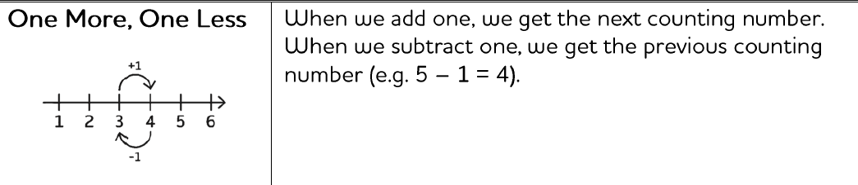
Wednesday afternoon fluency

Slide 8
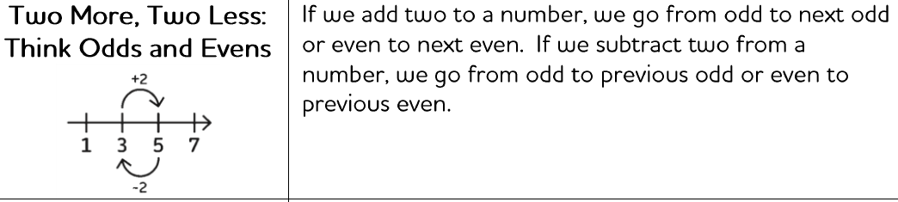
Thursday afternoon fluency

Slide 9
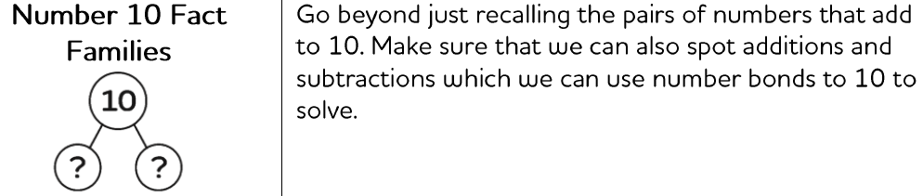
Friday afternoon Fluency

