Slide 1
28.02.22 Fluency
Fact of the day: 4 x 3=
Everyone | Extension
How many groups of 5 are there in 25? b. 12 ÷ ___= 4 c. Difference between: 67 and 73 (do in your head) d. 19 + 19= Missing numbers? 80 ___ 70 ___ 60 55 | f. Write in figures six thousand two hundred and four g. How many minutes are there in one and a quarter hours? h. What is the difference between eight hundred and one hundred and seventy-nine? i. Write the number between one hundred and ten and one hundred and twenty whose digits add up to six.

Slide 2
01.03.22 Fluency
Fact of the day: 9 x 4=
Everyone | Extension
What is the sum of 5 and fifty - five? b. How many tens in 170? c. 60p= ___p+ 10p d. Find the difference between 94 and 102 e. Add half of 8, to 25. | f. What is half of eight thousand five hundred? g. What is twenty out of forty as a percentage? h. How much must I add to four pounds ninety to make six pounds? What is three times three added to four times four? j. Calculate the perimeter of a rectangle which is eleven metres long and four metres wide.

Slide 3
02.03.22 Fluency
Fact of the day: 4 x 6=
Everyone | Extension
36 + 29 Round and adjust b. 66 + 19 Redistribute c. Write 872 in words d. 40cm + ___cm= 100cm ___ + 25cm = 100cm e. One quarter of 16= f. 1m and 5cm = _____cm g. 800cm = _____m | h. 2087 expanded: _____+ ___ + __+_ i. Which is bigger? 1/2 of 260 or 1/3 of 360 j. How many quarters in two and a quarter? k. Write the multiple of 6 nearest 20. l. When n has the value twelve, calculate five n minus two.

Slide 4
03.03.22 Fluency
Fact of the day: 4 x 12=
Everyone | Extension
Difference between 67 and 71 38 and 45 b. 100 minus 20 c. £1.75 + ___= £2.00 d. Double 15, then add 70. e. Half of £1.60 f. 650p= £___.____ | g. What number is thirty-four more than fifty-eight? h. 5 squared +___=200 i. A yogurt costs forty-five pence. How many yogurts can be bought for five pounds? Would there be any change? j. 50% sale. How much is an Easter egg priced £4.30?

Slide 5
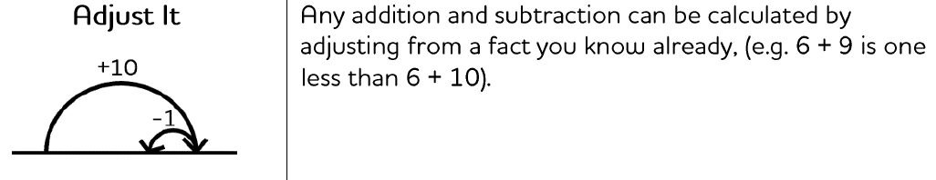
Monday afternoon fluency

Slide 6
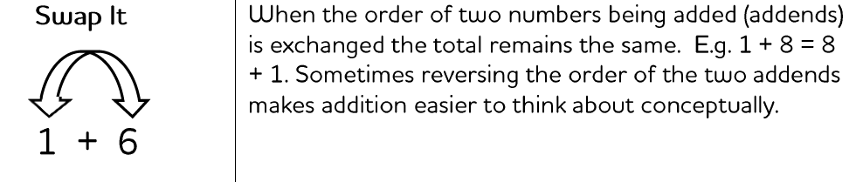
Tuesday afternoon fluency

Slide 7
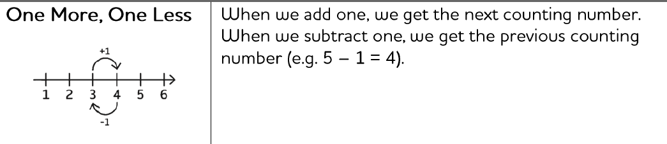
Wednesday afternoon fluency

Slide 8
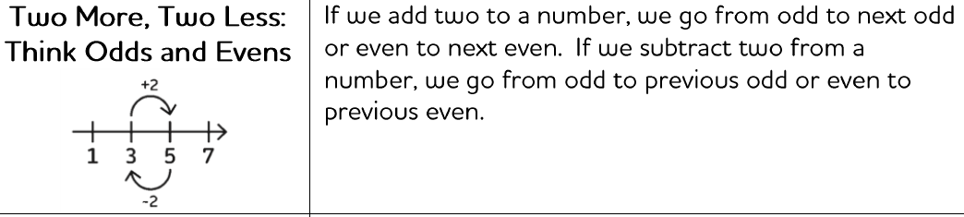
Thursday afternoon fluency

Slide 9
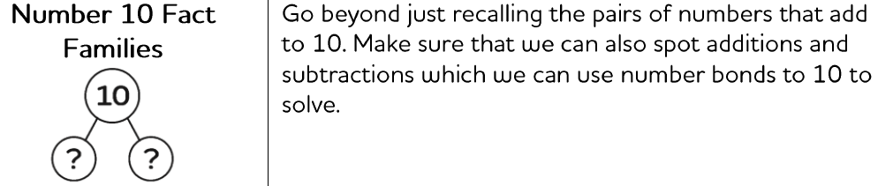
Friday afternoon Fluency

