Slide 1
28.03.22 Fluency
Fact of the day: 3 x 12=
Everyone | Extension
What is the sum of 176 and 65 (column) b. How many 10p in £1.30? c. 2m 6cm = ______cm d. Find the difference between 98 cm and 103cm e. Add half of 10, to 26. | f. Half of 2 l (litre) 500ml ? g. What is 15 out of 100 as a percentage? h. I need 530cm of rope. I have 1m 20cm. How much more do I need? 30 minutes more than 10.40am j. ____= 33 x 4 (you could x2 then x2 again) Show jottings

Slide 2
29.03.22 Fluency
Fact of the day: 6 x 3=
Everyone | Extension
26 + 19 Round and adjust b. 24 + 9 Redistribute c. Write 443 in words d. 89cm + ___cm= 100cm ___ cm + 25cm= 1m e. One quarter of 100= f. 2m and 7cm = _____cm g. 876cm = _____m ___cm | h. 8129 expanded: _____+ ___ + __+_ Add together eight and twelve, then multiply the result by fifty. j. How could you pay? Draw two ways with coins: £2.48 k. Write the multiple of 7 nearest 40. l. When n has the value 15, calculate 2n plus 2n.

Slide 3
30.03.22 Fluency
Fact of the day: 4 x 8=
Everyone | Extension
Difference between 37 and 41 48 and 55 b. 100 minus 25 c. £1.25 + ___= £2.00 d. Double 15, then add 20. e. Half of £2.30 f. 360p= £___.____ | g. What number is forty two more than one hundred and fifty-eight? h. 5 squared +___=100 A banana costs 25p. How much would 4 bunches of eight bananas cost? j. 50% sale. How much is an Easter egg priced £5.30?

Slide 4
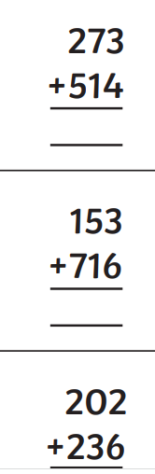
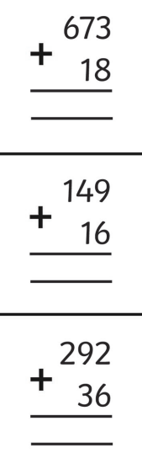
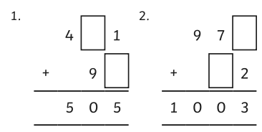
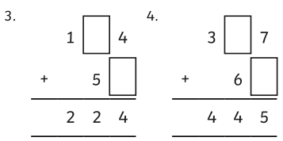
31.03.22 Fluency
Fact of the day: 4 x 6=
Everyone | Extension

Slide 5
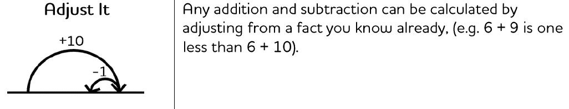
Monday afternoon fluency

Slide 6
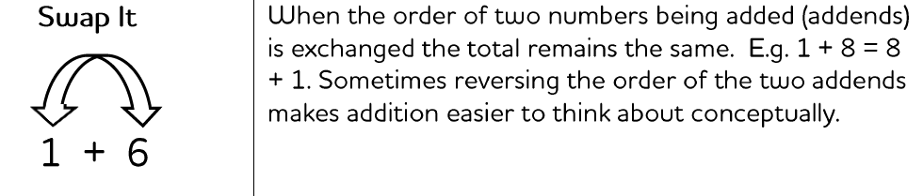
Tuesday afternoon fluency

Slide 7
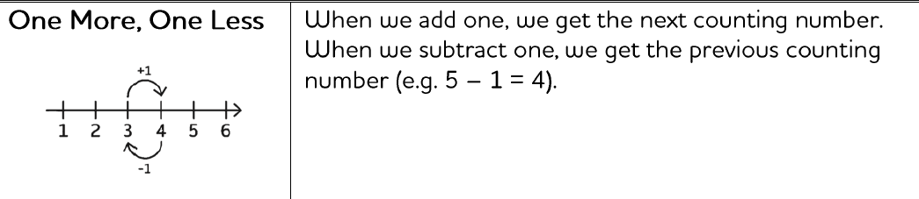
Wednesday afternoon fluency

Slide 8
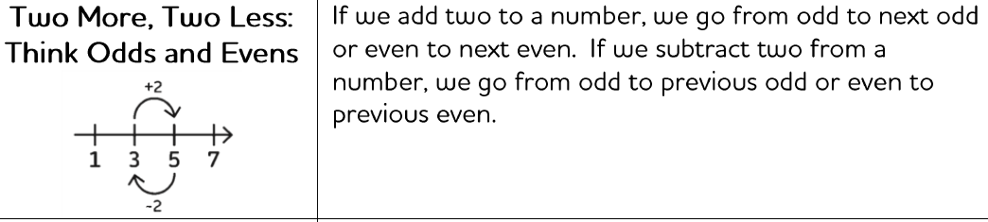
Thursday afternoon fluency

Slide 9
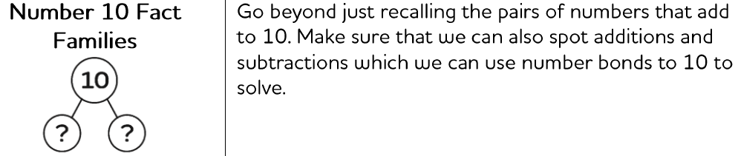
Friday afternoon Fluency

