Slide 1
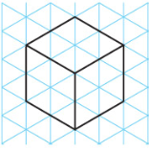

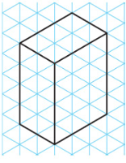
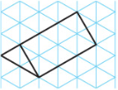
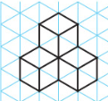
Drawing 3D shapes on Isometric paper

Slide 2
Drawing 3D shapes on Isometric paper
Have a go at the questions.
Remember that you need to use a pencil and ruler

Slide 3
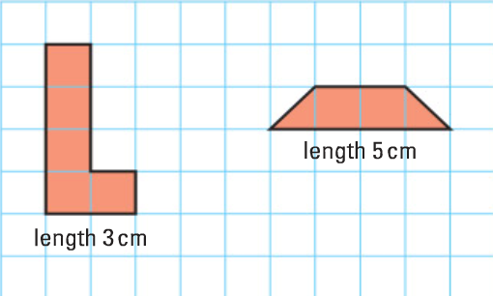
Drawing 3D shapes on Isometric paper

Slide 4
Drawing 3D shapes on Isometric paper

