Slide 1
Sum 2 wk 3 Homophones

Slide 2
5
These words are homophones or near homophones. They have the same pronunciation but different spellings and/or meanings.
26
Introduction | Ask the children what the word homophone means. Can they think of any examples? Define them as words which have the same pronunciation but different meanings and/or spellings. Discuss near homophones have slightly different pronunciations.
Main Teaching Activity | Ask children to look at the pictures on the power point slide and write down what each one is. Then try and write down the homophone that has the same pronunciation. Click to expose the answer. Compare answers with a partner and then share with the class.
Independent Activity | See if children can use the words from the main activity to create sentences which contain both homophones in the same sentence. E.g. I can see the sea from my garden. Share sentences with the class.
Spellings
aisle
isle
aloud
allowed
altar
alter
ascent
assent
farther
father

Slide 3


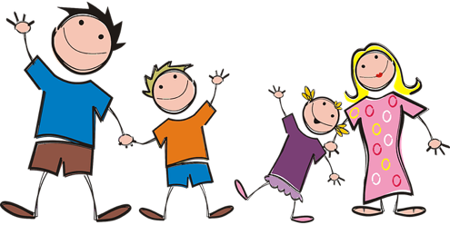
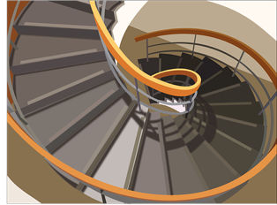

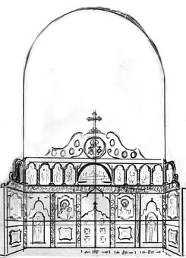
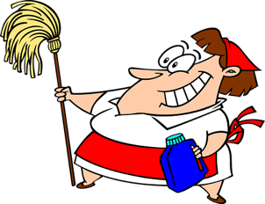

Choose 6 words to add to your bingo board.
toes
father
isle
stairs
maid
altar
sea
rose

Slide 4
Stage: 5 | Spelling Rules: These words are homophones or near homophones. They have the same pronunciation but different spellings and/or meanings. Name:
List: 26
Spellings | 1st Attempt | 2nd Attempt | 3rd Attempt
aisle
isle
aloud
allowed
altar
alter
ascent
assent
farther
father

Slide 5

Stage: 5 | Spelling Rules: These words are homophones or near homophones. They have the same pronunciation but different spellings and/or meanings. Name:
List: 26
Spellings
aisle
isle
aloud
allowed
altar
alter
ascent
assent
farther
father
Marvin has completed his homophone homework below.
Can you mark it for him. Correct any incorrect answers for him.
The aisle of Madagascar can be found off the coast of Africa.
Albert was nervous as he read aloud in front of the whole school.
The Bishop stood at the alter any prayed solemnly.
Tired and weary, the explorers began their assent to the summit.
“Just a little farther!” she said as they turned the corner.

Slide 6
Stage: 5 | Spelling Rules: These words are homophones or near homophones. They have the same pronunciation but different spellings and/or meanings. Answers:
List: 26
Spellings
aisle
isle
aloud
allowed
altar
alter
ascent
assent
farther
father
Marvin has completed his homophone homework below.
Can you mark it for him. Correct any incorrect answers for him.
The aisle of Madagascar can be found off the coast of Africa.
isle
Albert was nervous as he read aloud in front of the whole school.
The Bishop stood at the alter any prayed solemnly.
altar
Tired and weary, the explorers began their assent to the summit.
ascent
“Just a little farther!” she said as they turned the corner.

