Slide 1
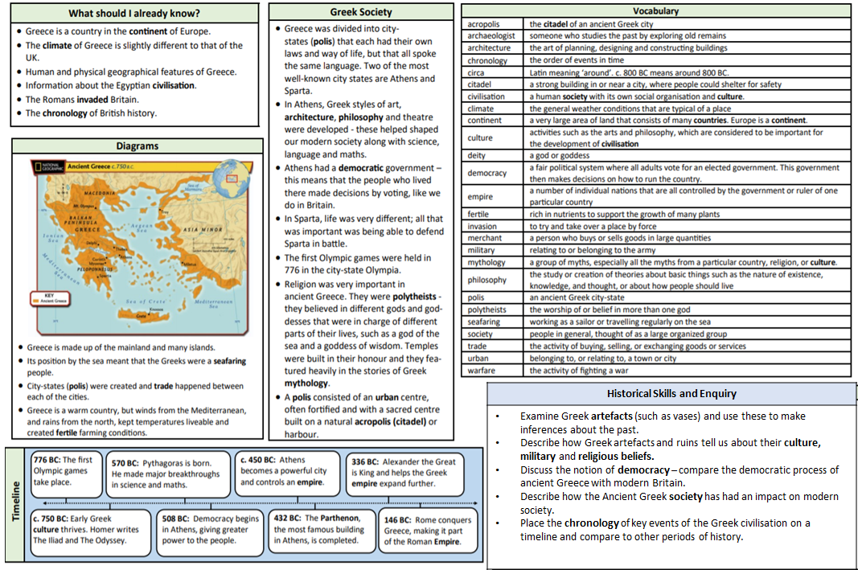
|Autumn 1 Knowledge Organiser – History – Ancient Greece - Civilisation|

